Slide 1

Music Genre Classification​
Serene Qasem, Jordan Carden, Chloe Gray

Slide 2
Brief Overview
The goal of this project is to classify music genres automatically based on audio characteristics. Organizes large music libraries/recommend songs based on a genre.
We approached CNN and Random Forest.
By comparing the two methods, we can see which approach works best and how to improve music categorization.

Slide 3
Data
We got our dataset from Kaggle, specifically GTZAN Dataset - Music Genre Classification
We have a collection of 10 genres with 100 audio files each, all having a length of 30 seconds.
There is also a visual representation for each audio file.
Two CSV files containing features of the audio files (3-second and 30-second audio feature sets).

Slide 4
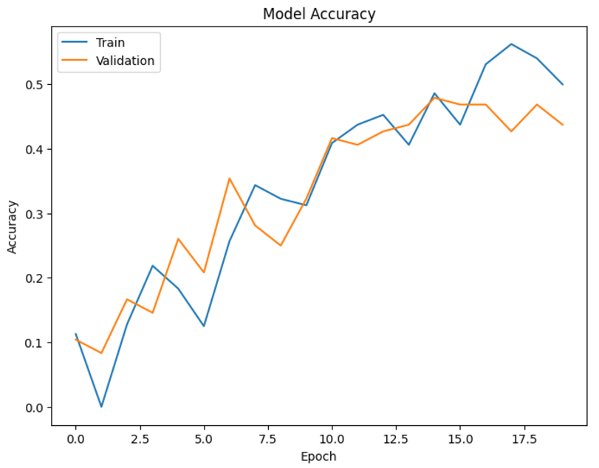
CNN (Image Processing)
Remove unnecessary white borders from spectrograms to focus on the audio data.
Method:
- convert images to grayscale.
- use contours to detect the largest bounding box.
- crop and save the images.
- 55% accuracy.

Slide 5
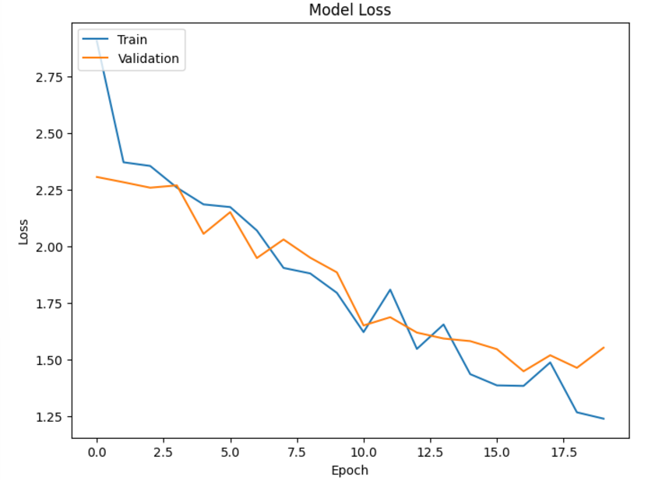
Model loss
- The validation loss is not reducing as quickly as the training loss is, suggesting overfitting.

Slide 6
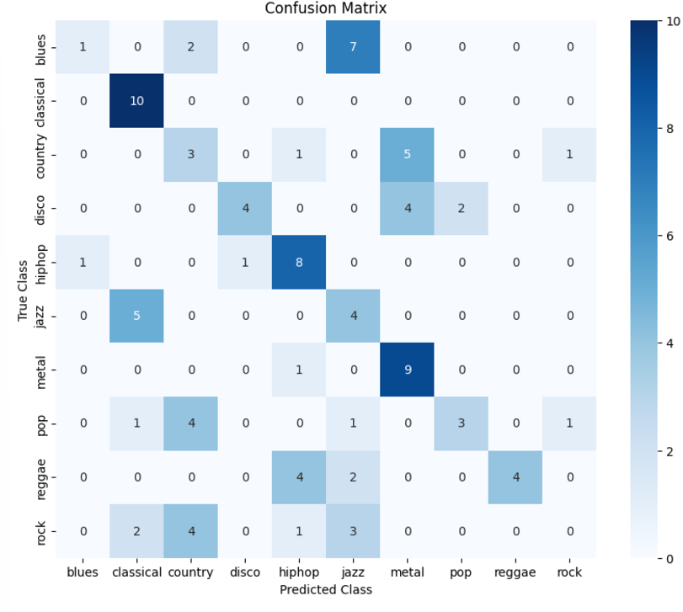
Confusion matrix
Classical, Hip-Hop, and metal seem to be the best performing genres.

Slide 7
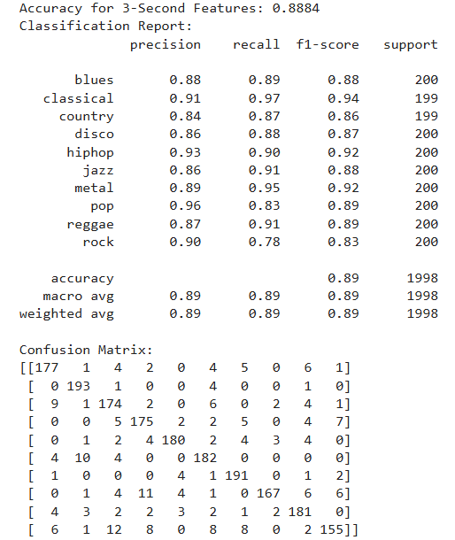
Random Forest
- The smaller time window provides finer-grained details, which helps with classification.
- This dataset performed the best, achieving near 89% accuracy on unseen data.

Slide 8
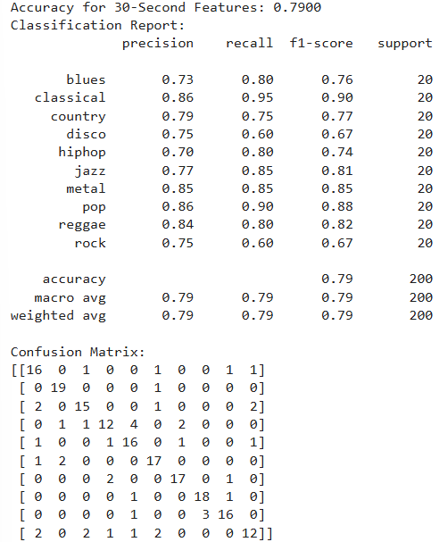
Random Forest
- The longer time window might generalize better but seems to lose some precision for genre classification.

Slide 9
Learned
What we
Random Forest remains a strong baseline for structure datasets. Won over CNN.
Combining CNN and Random Forest may improve genre classification
Reprocessing impacts CNN performance significantly (when we removed white borders).

